Slide 1


Ghana e-health framework
Joint ITU-WHO Workshop on
e-Health Standards and Interoperability
(Geneva, Switzerland, 26-27 April 2012)
Dominic K Atweam
Health information system analyst
Policy planning monitoring and evaluation division
Ghana Health Service
(dominic.kobinah@ghsmail.org)
Geneva, Switzerland, 26-27 April 2012

Slide 2
Part 1
Geneva, Switzerland, 26-27 April 2012
Notes:
PART 1 – Ghana e-health Framwork
PART 2 – Addressing our interoperability Issues

Slide 3
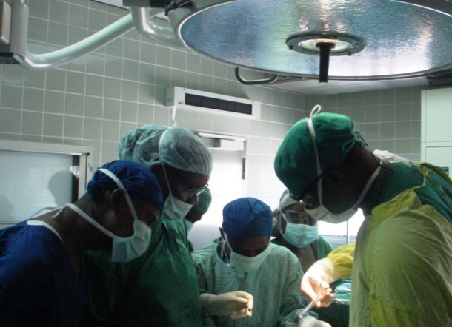


.

Slide 4
Background
1.Overview of eHealth
2.Current Situation
3.Strategies
4.Implementation challenges

Slide 5

Overview of eHealth in Ghana (1)
  Country Perspective
  ICT 4AD strategic plan-2003
  National EA and eGIF framework
  Health Sector ICT Policy and Strategy-2005
  National eHealth Policy and Strategy
Notes:
This image is the frontage of Ghana ICT for accelerated Development strategic plan. It is the blueprint and road map for the rollout of ICT in the country. Highlight some of the content. Provide a brief explanation of the National EA and eGIF and the fact that both documents emanates from the ICT4AD.Mention the EA for the GHS and how it addresses the eHealth interoperability issues.These document highlight the concerns relating to the Confidentiality,Integrity,Availability,Disclosure and storage of data and other information.
There is ongoing work to address data and information protection.We have only working guidelines based conventional best practices in the IT and Health care industry.

Slide 6

Overview of eHealth in Ghana (2)
  Country Perspective
  GHS Enterprise Architecture
  National Health Insurance Scheme-(NHIS)
Notes:
This image is the frontage of Ghana ICT for accelerated Development strategic plan. It is the blueprint and road map for the rollout of ICT in the country. Highlight some of the content. Provide a brief explanation of the National EA and eGIF and the fact that both documents emanates from the ICT4AD.Mention the EA for the GHS and how it addresses the eHealth interoperability issues.These document highlight the concerns relating to the Confidentiality,Integrity,Availability,Disclosure and storage of data and other information.
There is ongoing work to address data and information protection.We have only working guidelines based conventional best practices in the IT and Health care industry.

Slide 7


Current Situation-Infrastructure
  eGovernance ICT Platform
  NHIS ICT Infrastructure
  Networking of health facilities
  Internet Connectivity
Notes:
The Ministry of Communication and the NITA (National Information Technology Authority) has started the deployment of the national fibre back bone.The community information centre have been operationalised for the districts.NHIS WAN for claims management.
Wide coverage of internet access and coverage is via VSAT,ADSL, and dial up

Slide 8


Current Situation-Capacity Building
School of public health BSc, Msc in Health Informatics
School of Allied Science-Kintampo for certificate and Diploma in Health Informatics
Huawei MOH e-learning project in all Health training institution
MIDA –Ghana Project
Notes:
DHIMS2. DiHPART are core subjects
Huawei project, connecting all training institution for e-learning plaform

Slide 9
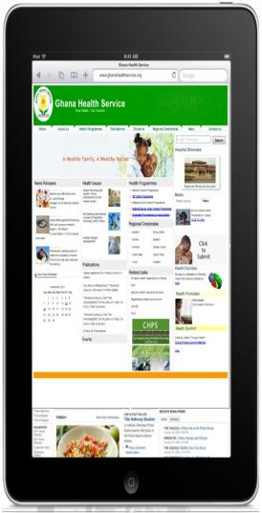
Current Situation - mHealth Project
Sene smart phone project
MoTeCH
MVP Project-telemedicine
EWS
SMS for life
Fio-GHS
RDT smart reader
Notes:
HUMAN CAPITAL: tech skill set to maintain database & program in mobile phone context
FINANCE – sustainability
CONNECTIVITY –eractic connectivity? gprs? Wireless? Wimax? wifi,? Secured network? Etc
MOBILE OS – ios, sembian, android,
SECURITY –handset, privacy, availability, confidentiality, data protection, medico legal
HMIS – integration through web base HMIS instead of stand alones

Slide 10


Current Situation - HMIS
  DHIMS 2
    www.ghsdhims.org
  iHost (GHS)
  HAMS( private initiative)
  NHIA – eClaims
  Motech and Sene SMART PHONE
    Produce aggregated reports for input into DHIMS2
Notes:
DHIMS2 DEPLOYED IN 170 districts for capturing all aggregated service delivery data in the country from the district and some sub district level

Slide 11
GHS IT Architecture
Data
Aggregated Data
and Reports
DHIMS (Clinical
And Business
Reporting)
Data Warehouse
For Health Care
Transactions
Data Warehouse
and Archive
IHost
(Inpatient and
Outpatient Electronic
Health Records)
Smart phones for
Service Delivery
(Public Health Electronic
Health Records)
Other Data
Data Collection
Systems
(Surveys, etc)
Health Care Transactions and Electronic Health Records

Slide 12

Current Situation-
Security, Privacy, etc.
  Patient identifiable information
  Source codes
  Access to data
  Ownership of data
  Business Continuity

Slide 13
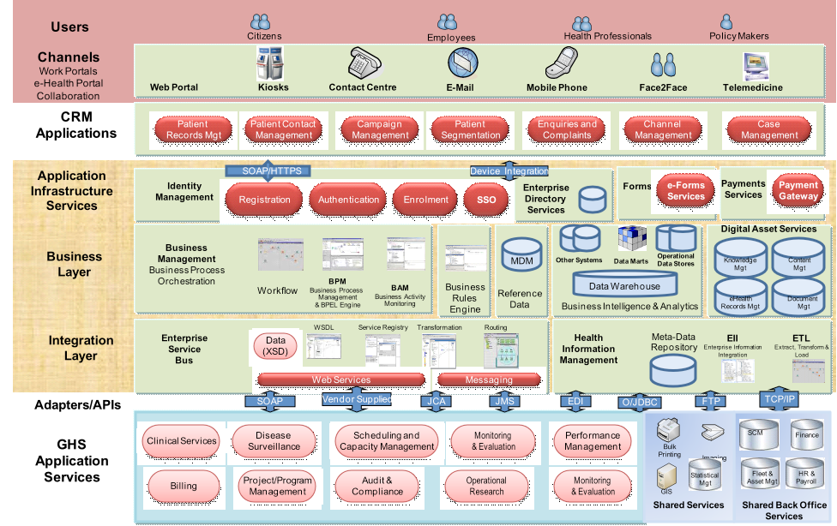
Notes:
Business, Applications, Data & Technical Architecture.

Slide 14
Part 2
Proposed Interoperability Solutions
Geneva, Switzerland, 26-27 April 2012
Notes:
The Ghana Health Service recognising the need to integrates all the e-health initiatives , we requested for Interoperability solutions as defined in our GHS EA one that can address integrating all our e-health (HMIS) initiatives .

Slide 15
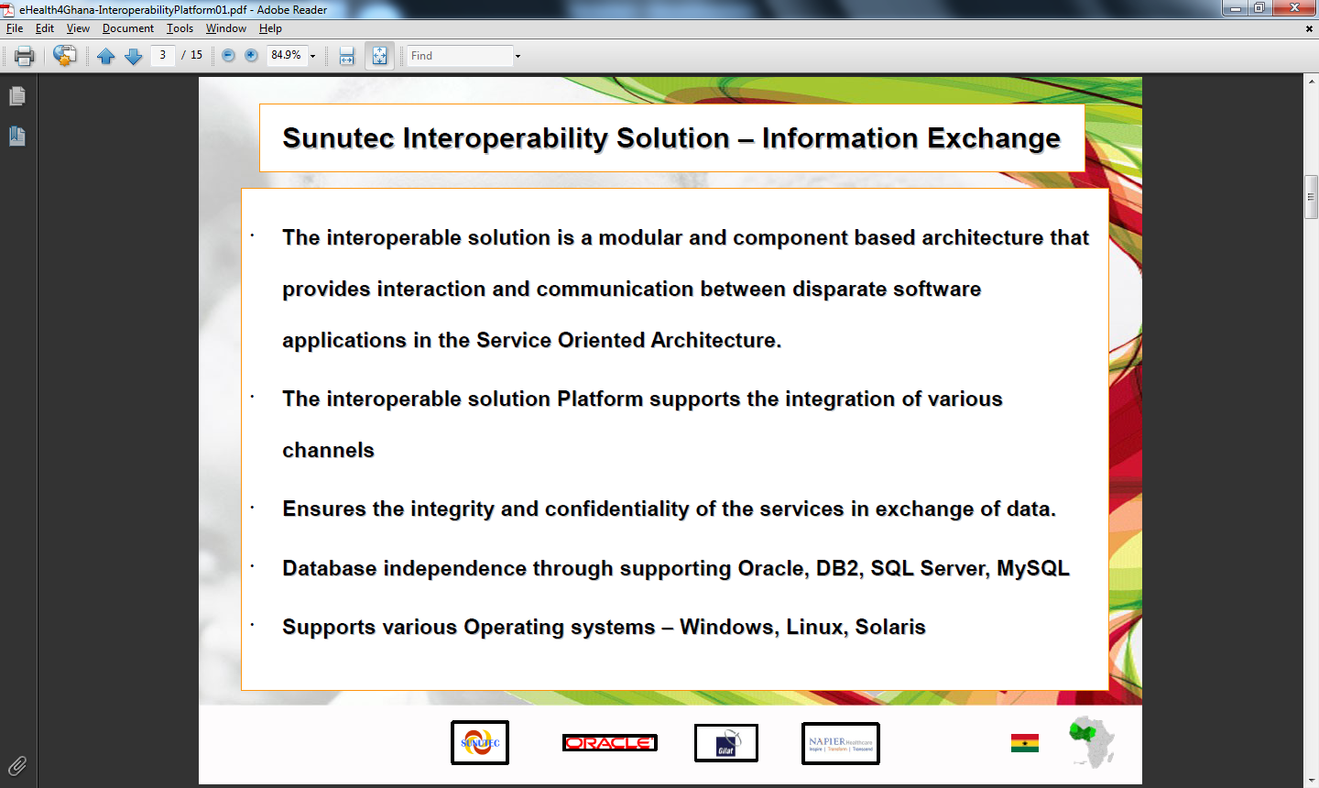
Interoperability Solution – Information Exchange
Notes:
With the back ground of some of the e health initiatives that we have we indicated our term of reference

Slide 16

Proposed Interoperability Solution
Interoperability solution on the GHS Integration Platform should address the interoperability issues adhering to the Ghana Health Service Enterprise Architecture and following the Ghana Health Service IT Initiatives.
    Public Private Partnership
• This solution should establish a bridge between Interoperable solution and various systems and reduces the negotiation required to exchange data by imposing the data transfer standards.
• The solution also should provide a path for the various applications to conform to standards and streamlining the data transfer format generalizing the various formats to certain standards, by providing secure and reliable way of communication.
• The solution includes outbound as well as inbound activities.

Slide 17
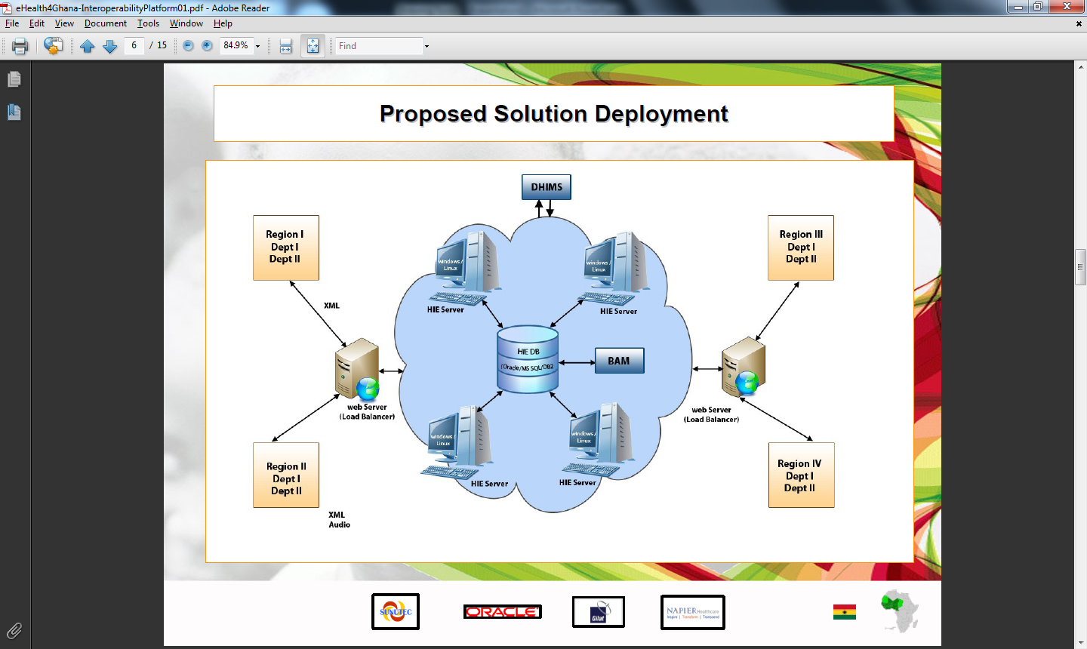
Proposed solution deployment

Slide 18
Proposed solution deployment
Interoperable solution should be capable of configurable parameters in communicating with multiple destinations and multiple sources.
• Custom Adapters that can be added for any new integration communication mechanism.
• A solution that provides automatic management of business processes and supports business process orchestration through work flow.
• In the solution, Business Rules engine should facilitates the interactions and enables the decisions based on predefined conditions.
This interoperable solution should also provides the confidentiality, integrity of data by enabling security measures in the transmission of data in the integration platform

Slide 19
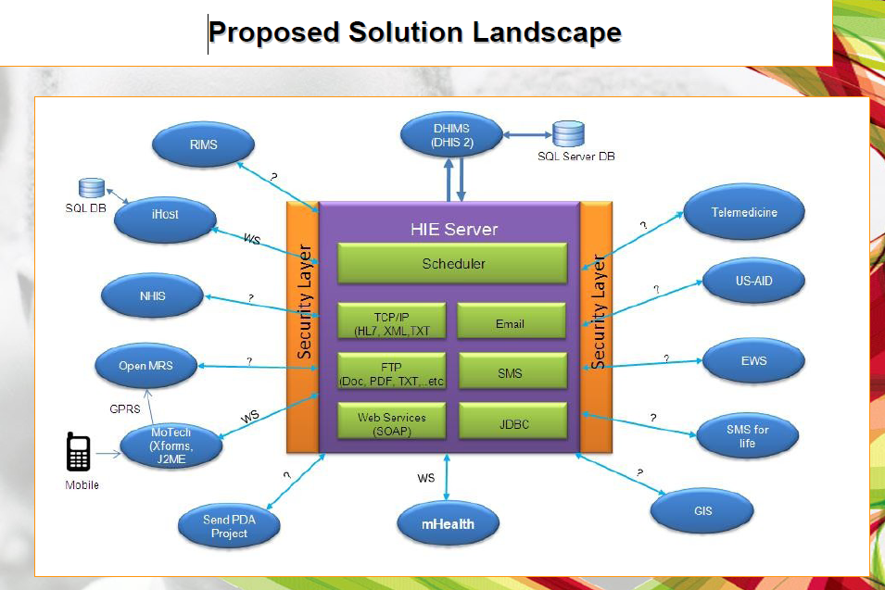
Proposed Solution Landscape
Notes:
This is one of the main solution that has been provided for our consideration

Slide 20
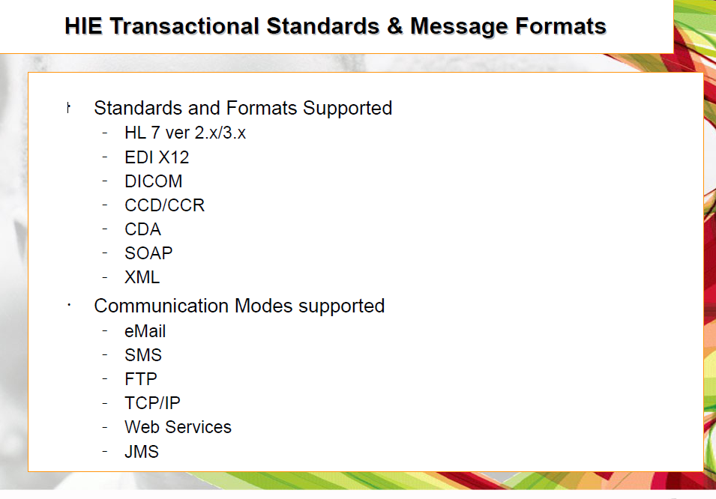
Notes:
GHS is now working on providing more information to the vendor on all our e – health transactional and message format, communication modes that is supported , data base, OS, server plat form security etc

Slide 21
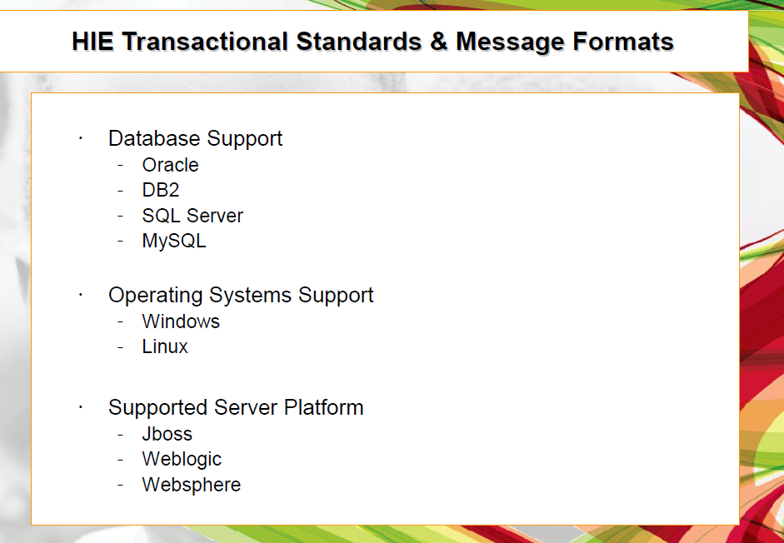
Notes:
GHS is now working on providing more information to the vendor on all our e – health transactional and message format, communication modes that is supported , data base, OS, server plat form security etc

Slide 22
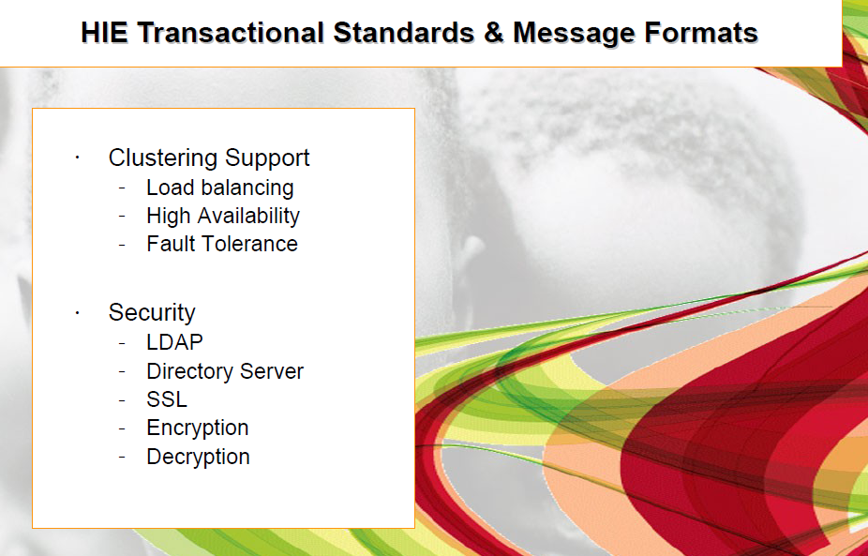
Notes:
GHS is now working on providing more information to the vendor on all our e – health transactional and message format, communication modes that is supported , data base, OS, server plat form security etc

Slide 23
Open questions
What are the various data input formats (XML, text file etc) expected by the disparate system?
What are the different mediums in which the data will be exchanged (Web services, TCP/IP, Plain Txt file, FTP, SMS, E mail, etc) and other than these medium are there any other medium required?
Does each of the system have web services already developed to interface with third party Information Exchange
If YES, are the standards, formats and data elements already defined for different transaction type
If not, would we be required to develop the interfaces for each of the system
Is Customer looking for a transaction based data transmission or a batch process
If Batch process, do customer have interfaces developed that can be called to access the data
Geneva, Switzerland, 26-27 April 2012
Notes:
These were some of the open question GHS is working on on all our e-health initiaves

Slide 24
Open Questions
If none of the required exchange interfaces are ready, can we get system details to develop them and call our adapters ( This will need in-depth analysis of existing systems and validation of the interfaces that will be newly developed)
Whether all the applications are having DB?
Do all the existing applications support web services?
What is the each system data storage mechanism and the interface exposing mechanism?
Are there any applications which are not having data store (only real time)?
Geneva, Switzerland, 26-27 April 2012

Slide 25
Main Challenege
Its been difficult getting some
of these information on the systems
    No proper documentation on system architecture.
    Admin manual are not available
Geneva, Switzerland, 26-27 April 2012

Slide 26
Thank You

